Slide 1


Securing AI Apps on Azure: Data Access Control for AI RAG Apps on Azure
aka.ms/securing-acl-slides
Matthew Gotteiner
Azure AI Search
Pamela Fox
Python Cloud Advocacy
github.com/pamelafox

Slide 2
Retrieval Augmented Generation

Slide 3




RAG: Retrieval Augmented Generation
Yes, your company perks cover underwater activities such as scuba diving lessons ¹
Do my company perks cover underwater activities?
PerksPlus.pdf#page=2: Some of the lessons covered under PerksPlus include: · Skiing and snowboarding lessons · Scuba diving lessons · Surfing lessons · Horseback riding lessons These lessons provide employees with the opportunity to try new things, challenge themselves, and improve their physical skills.….
User
Question
Search
Large Language Model
Notes:
Pamela present
In my part of the session, my goal is show you how to add user authentication to an AI app. First lets check out the base AI app.

Slide 4
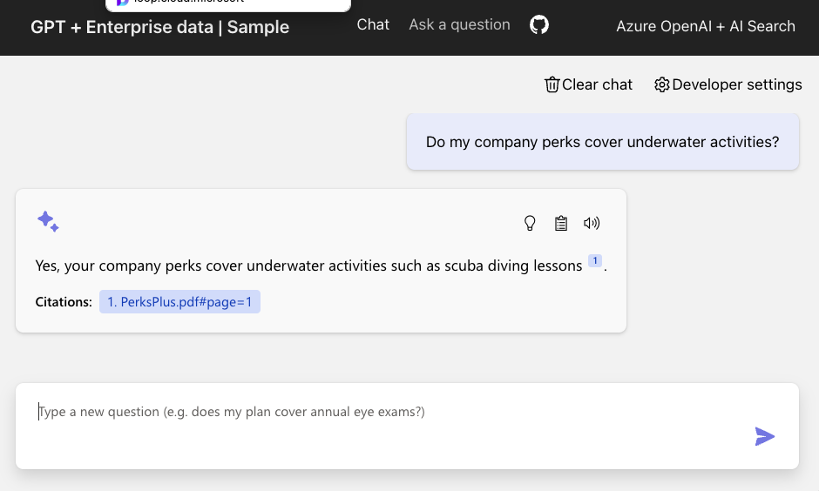
RAG solution: Demo
aka.ms/ragchat

Slide 5
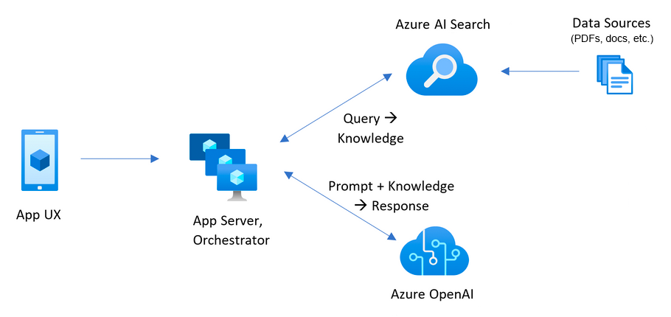
RAG solution: Architecture
aka.ms/ragchat
Notes:
Pamela present
In my part of the session, my goal is show you how to add user authentication to an AI app. First lets check out the base AI app.

Slide 6





Data prep: Local data ingestion
See prepdocs.py for code that ingests documents with these steps:
Azure Blob Storage
Azure Document
Intelligence
Azure OpenAI
Azure
AI Search
Python
Upload documents
An online version of each document is necessary for clickable citations.
Extract data from documents
Supports PDF, HTML, docx, pptx, xlsx, images, plus can OCR when needed.
Local parsers also available for PDF, HTML, JSON, txt.
Split data into chunks
Split text based on sentence boundaries and token lengths.
Langchain splitters could also be used here.
Vectorize chunks
Compute embeddings using OpenAI embedding model of your choosing.
Indexing
Document index
Chunk index
Both

Slide 7
RAG solution: Code (Simplified)
aka.ms/ragchat
# STEP 1: Query rewriting with AI Search query_text = openai_client.chat.completions.create(
messages=query_messages, temperature=0.0, max_tokens=100
).choices[0].message.content
# STEP 2: Retrieval
search_vector = openai_client.embeddings.create(
self.embedding_model, input=query_text
).data[0].embedding
results = search_client.search(
search_text=search_text, top=3,
vector_queries=VectorizedQuery(vector=search_vector, fields="embedding"),
query_type=QueryType.SEMANTIC, semantic_configuration_name="default",
semantic_query=query_text,
)
# STEP 3: Question answering
answer = openai_client.chat.completions.create(
messages=messages, temperature=0.3, max_tokens=1024
).choices[0].message
Notes:
Pamela present
In my part of the session, my goal is show you how to add user authentication to an AI app. First lets check out the base AI app.

Slide 8
Protecting data with access control in a RAG application

Slide 9
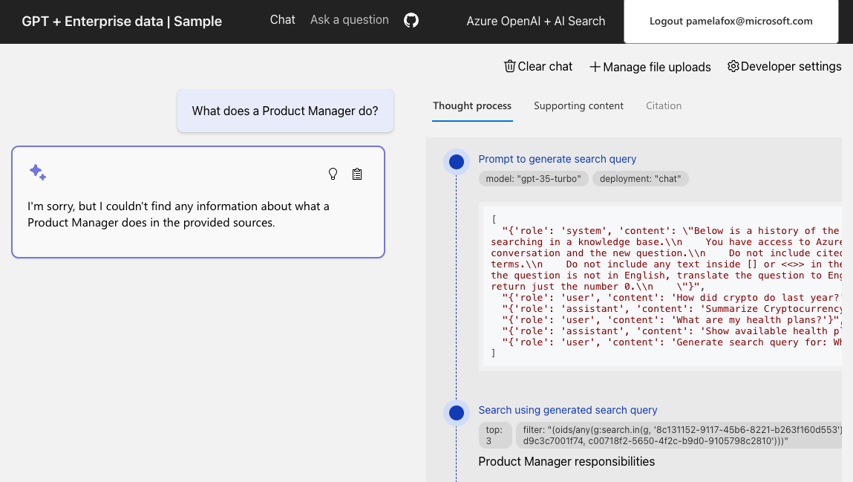
RAG with Data ACL: Demo
aka.ms/ragchat/acl

Slide 10
RAG with Data ACL: Architecture
aka.ms/ragchat/acl
User filter +
Notes:
Pamela present
In my part of the session, my goal is show you how to add user authentication to an AI app. First lets check out the base AI app.

Slide 11
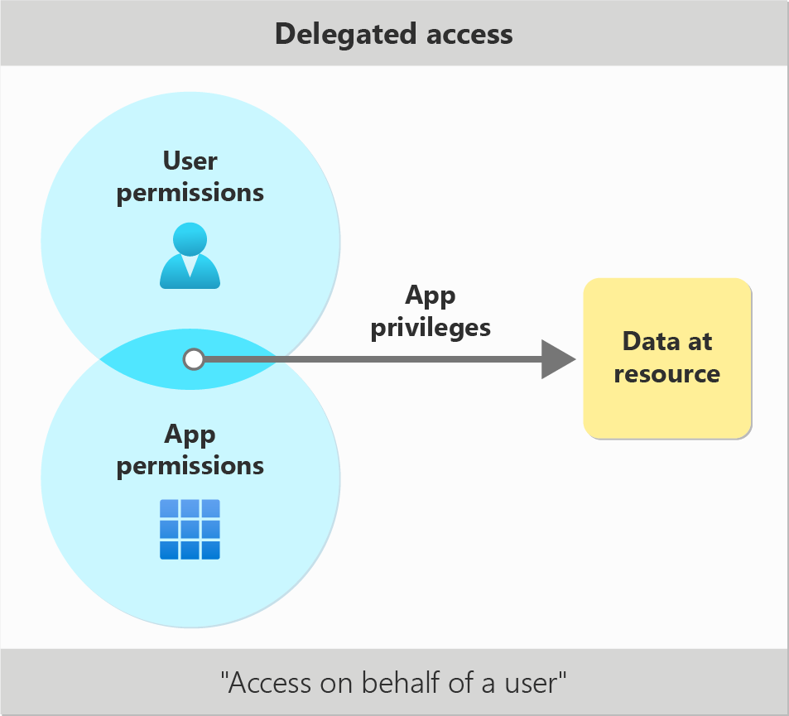
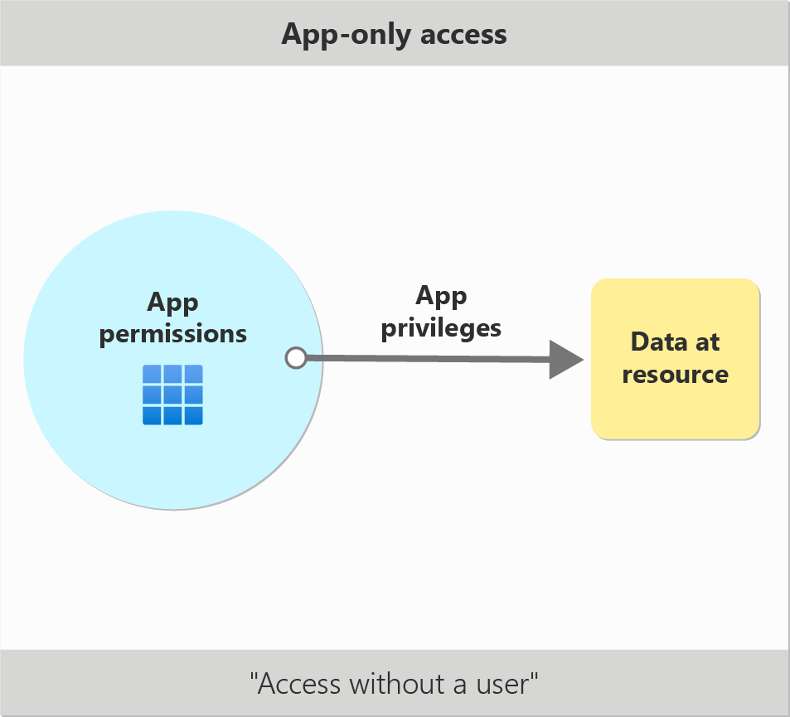
How do clients access resources?
Two types of access: Delegated and App-only

Slide 12
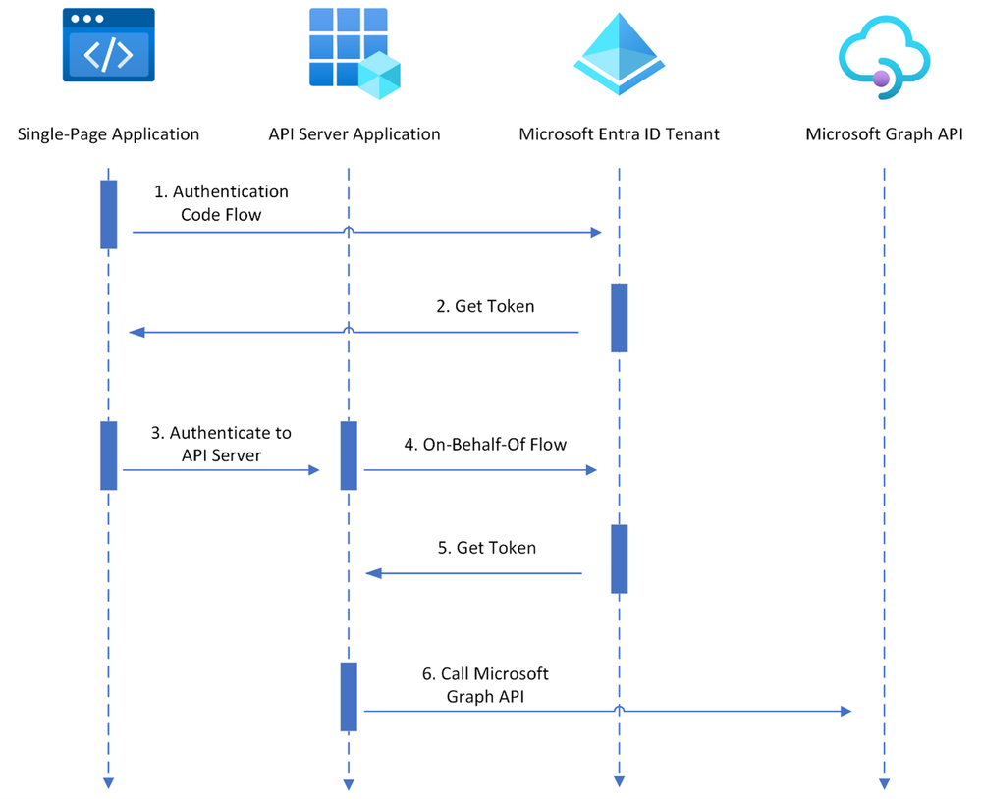
User authentication in SPA apps

Slide 13
Understanding token claims
Access tokens use the JSON Web Tokens (JWT) format.
Claims, or key-value pairs, establish facts about the subject the token was issued for.
Try decoding a token yourself at https://jwt.ms.
{
"aud": "https://management.core.windows.net/", // Token Audience (Resource Server)
"iss": "https://sts.windows.net/f6a799a2-eb93-4e7f-9515-19e4a2e7af04/", // Token Issuer
"iat": 1714775919, // Issued at time
"nbf": 1714775919, // Do not process token before this time
"exp": 1714780517, // Expiry time
"name": "Matt G", // Display name of the user
"oid": "8d5a813e-af85-47f1-b076-0b88e9cf8443", // Object identifier of the user
"groups": ["b415f9c9-4f20-45b4-87a1-0ac9a142f0c5"], // Identifiers of user groups
"scp": "user_impersonation" // OAuth 2.0 scopes that have been consented to
}
Notes:
Add syntax highlighting

Slide 14
Representing access control in AI Search indexes
Search supports string collection fields.
Directly map object and group identifiers from token claims to documents in the index.
{
"name": "index-with-access-control",
"fields": [
{ "name": "key", "type": "Edm.String", "key": true },
{ "name": "oids", "type": "Collection(Edm.String)", "filterable": true },
{ "name": "groups", "type": "Collection(Edm.String)", "filterable": true }
]
}

Slide 15
Access control using filtering
AI Search supports filtering documents in addition to normal searches.
Efficiently search thousands of unique identifiers using "search.in".
{
"search": "document text" ,
"filter": "oids/any(oid: search.in(oid, '3fd9a875-2e3d-4b97-8301-eb7b7e6a109e, a11be098-87b6-4c68-af19-79e44d927c4d, ...')) or groups/any(group: search.in(group, 'e432e4cd-8e1c-4a5e-9c0a-6e1fa3a6bb8d, 6f091fd9-5871-4d1b-8fd5-3dbef48b52a9, ...')"
}

Slide 16
Updating access control associated with a document
AI Search supports incremental updates to individual records
Include document key, "merge" action, and fields to update
{
"value": [
{
"@search.action": "merge",
"key": "my-document-key",
"oids": [ "c0f84485-7814-49b2-9128-9b3a5369c423", "7dc3d6e8-8d6b-4ae4-b288-8d50d605df55" ],
"groups": [ "f2b17199-8ec8-41b0-b0d7-1a6ad597f96e", "e5e0b705-993b-4880-81c8-3b0a3f7345f7" ]
}
]
}

Slide 17
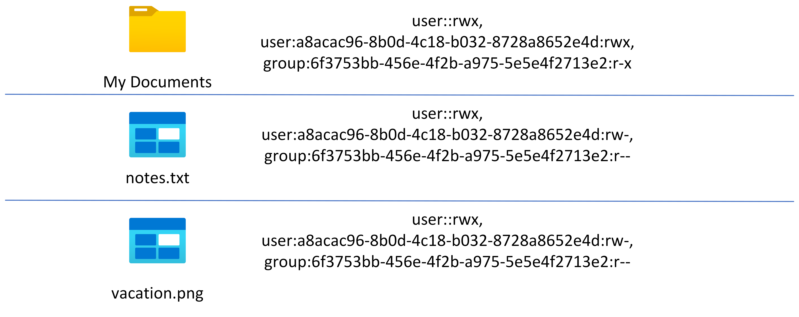
Combining AI Search and Data Lake Gen2 Storage
Data Lake Gen2 Storage allows associating access control information with files and folders
Notes:
Do the full app flow, show the URLs

Slide 18
Fetching access control information
Fetch access control list from files or directories
Need to parse string to find exact group and object ids
from azure.storage.filedatalake import DataLakeServiceClient
from azure.identity import DefaultAzureCredential
service_client = DataLakeServiceClient(account_url="https://account.dfs.core.windows.net", credential=DefaultAzureCredential())
file_system_client = service_client.get_file_system_client("container")
file_client = file_system_client.get_file_client("My Documents/notes.txt")
# Request ACLs as GUIDs by setting user principal name to false
access_control = file_client.get_access_control(upn=False)
acl = access_control["acl"]
# ACL Format: user::rwx,group::r-x,other::r--,user:xxxxxxxx-xxxx-xxxx-xxxx-xxxxxxxxxxxx:r--
acl_list = acl.split(",")

Slide 19
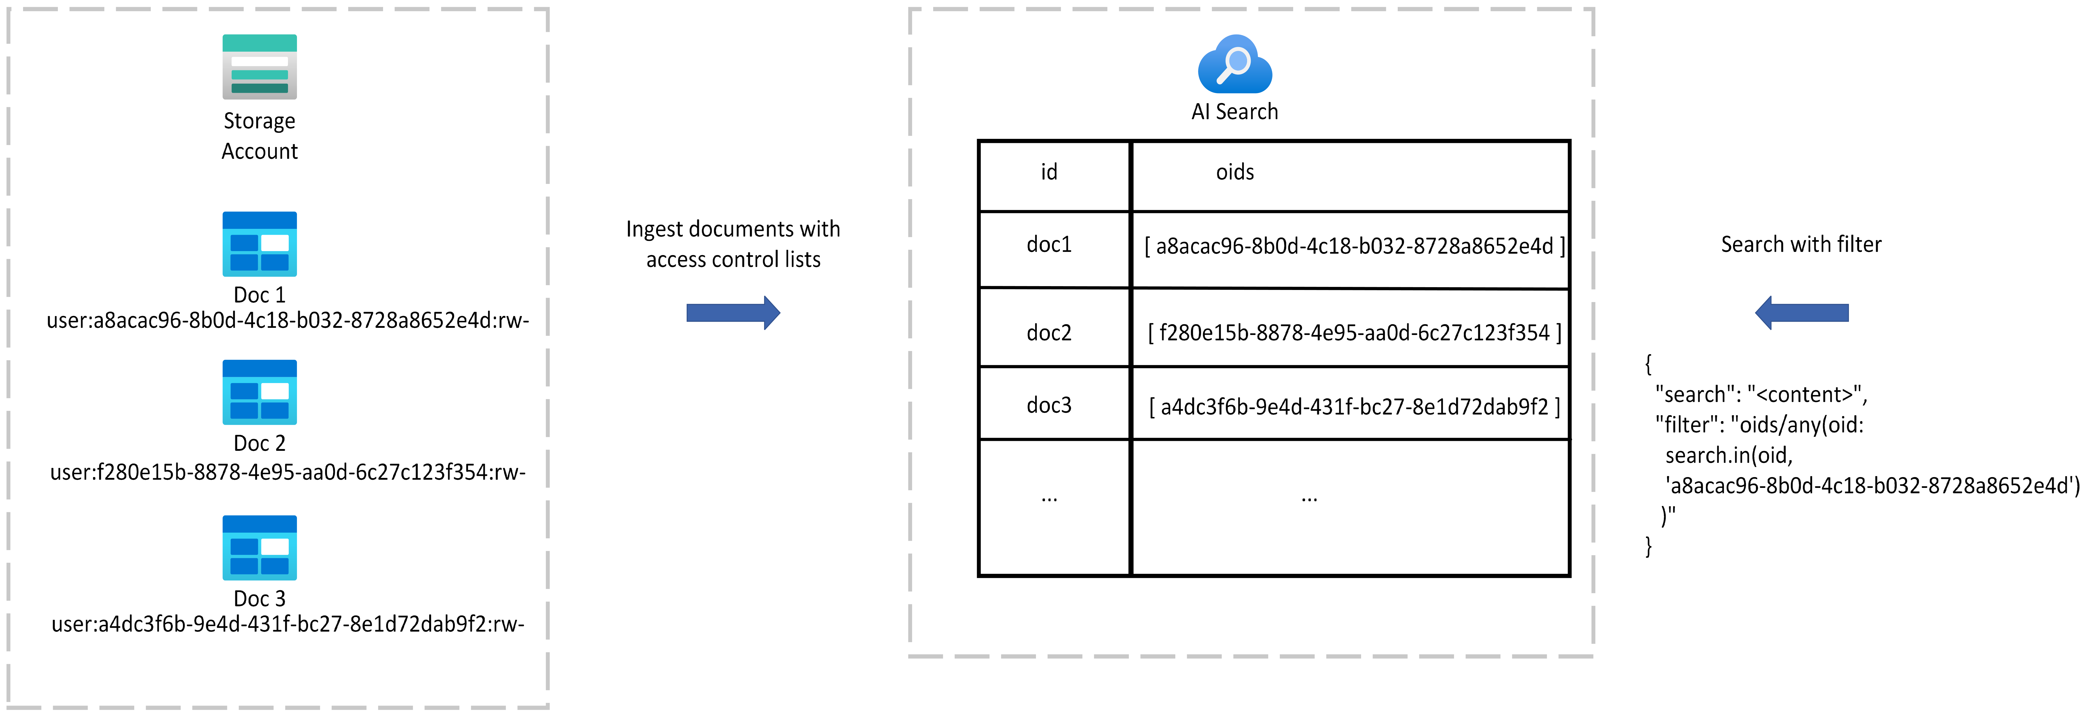
Lifecycle of data with access control information
Option 1: Ingest the documents from a data source with access control information

Slide 20
Lifecycle of data with access control information
Option 2: Ingest the documents from a data source without access control and join them with access control information

Slide 21
Why not just use an index per user?
AI Search limitations mean you have a finite number of indexes per search service
S3 HD index max size is 100GB
Tier | Free | Basic | S1 | S2 | S3 | S3 HD | L1 | L2
Maximum indexes | 3 | 15 | 50 | 200 | 200 | 1000 per partition, max 3000 per service | 10 | 10

Slide 22
User-uploaded documents in a RAG application

Slide 23
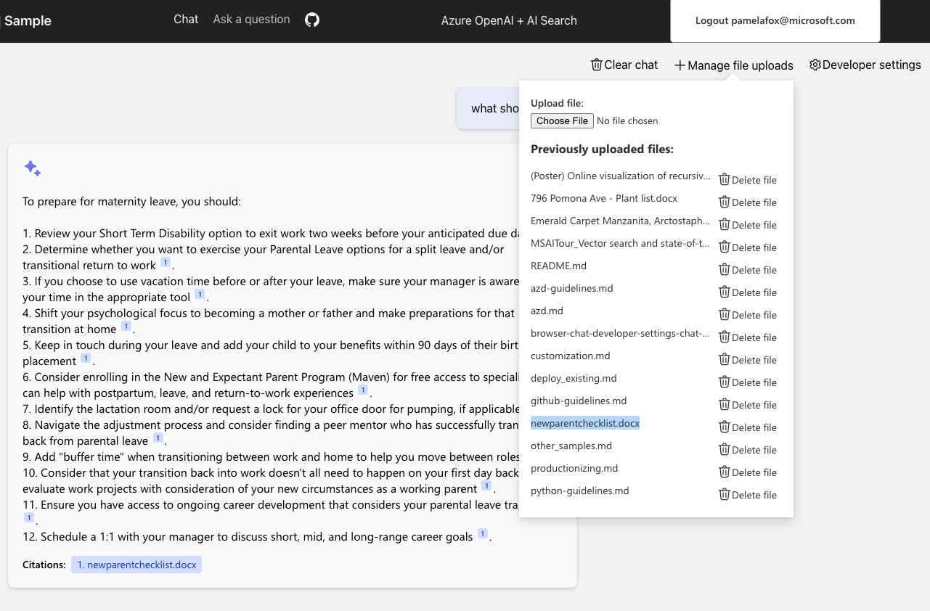
RAG with user upload: Demo
aka.ms/ragchat/upload

Slide 24
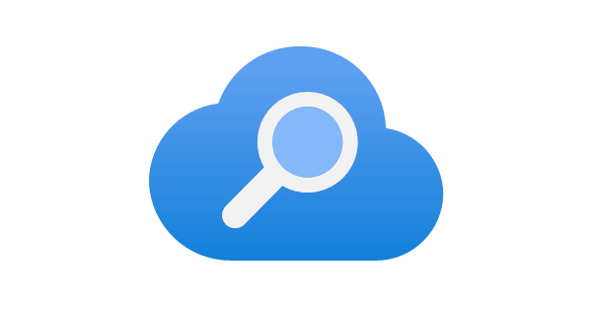



User upload steps
aka.ms/ragchat/upload
Store
Extract
Split
Embed
Index
newparentchecklist.docx
Azure Data Lake
Storage Gen2
(ADLS2)
Azure Document
Intelligence
Azure OpenAI
Azure AI Search
field | value
oids | 8c131152-9117-45b6-8221-b263f160d553
sourcefile | newparentchecklist.docx
storageurl | https://userst24ccg67vinxu2.dfs.core.windows.net/user-content/8c131152-9117-45b6-8221-b263f160d553%2Fnewparentchecklist.docx
content | 5 days per week for 4 weeks or half-days every day for 4 weeks), contact AskHR or call (425) 706-8853 for assistance prior to your return.
embedding | [0.0060971826, 0.0015850986 ...]
8c131152-9117-45b6-8221-b263f160d553
azd-guidelines.md
+ newparentchecklist.docx
Notes:
Show in the Azure Portal

Slide 25
User upload code
aka.ms/ragchat/upload
user_oid = auth_claims["oid"]
file = request_files.getlist("file")[0]
user_directory_client = user_blob_container_client.get_directory_client(user_oid)
try:
user_directory_client.get_directory_properties()
except ResourceNotFoundError:
user_directory_client.create_directory()
user_directory_client.set_access_control(owner=user_oid)
file_client = user_directory_client.get_file_client(file.filename)
file_io = io.BufferedReader(file)
file_client.upload_data(file, overwrite=True, metadata={"UploadedBy": user_oid})
file_io.seek(0)
ingester.add_file(File(content=file_io, acls={"oids": [user_oid]}, url=file_client.url))
Notes:
Also show the content_path code

Slide 26
Next steps

Slide 27
Try our samples and learn more!
Find more samples at:
aka.ms/azai
Java
JavaScript
Python
.NET
OpenAI
Assistants
Fine-tuning
...and more!
Azure OpenAI + AI Search + Entra + MSAL + App Service Built-in Auth
aka.ms/ragchat
Blog: Access Control in Generative AI applications with AI Search
aka.ms/rag-access-control
Microsoft Entra developer center
aka.ms/dev/ms-entra
Notes:
Pamela present

